Slide 1
Platform Automation for PCF

Slide 2
Platform Automation for PCF
Platform Automation for PCF provides the building blocks for teams to create a repeatable and reusable automated pipeline for upgrading and installing their PCF foundations.

Slide 3
Overview
Platform Automation for PCF:
Works with Concourse and leverages Concourse tasks
Contains and extends om commands (the Ops Manager API)
Provides an example pipeline to show how to string together tasks

Slide 4
Overview cont.
Platform Automation for PCF provides commands that enable PCF platform engineers to script and automate Ops Manager actions. The commands are:
Legible - the commands use human readable YAML files which can be edited and managed
Modular - each command has defined inputs and outputs that perform granular actions
Repeatable - re-running the commands in the CI won’t break builds

Slide 5
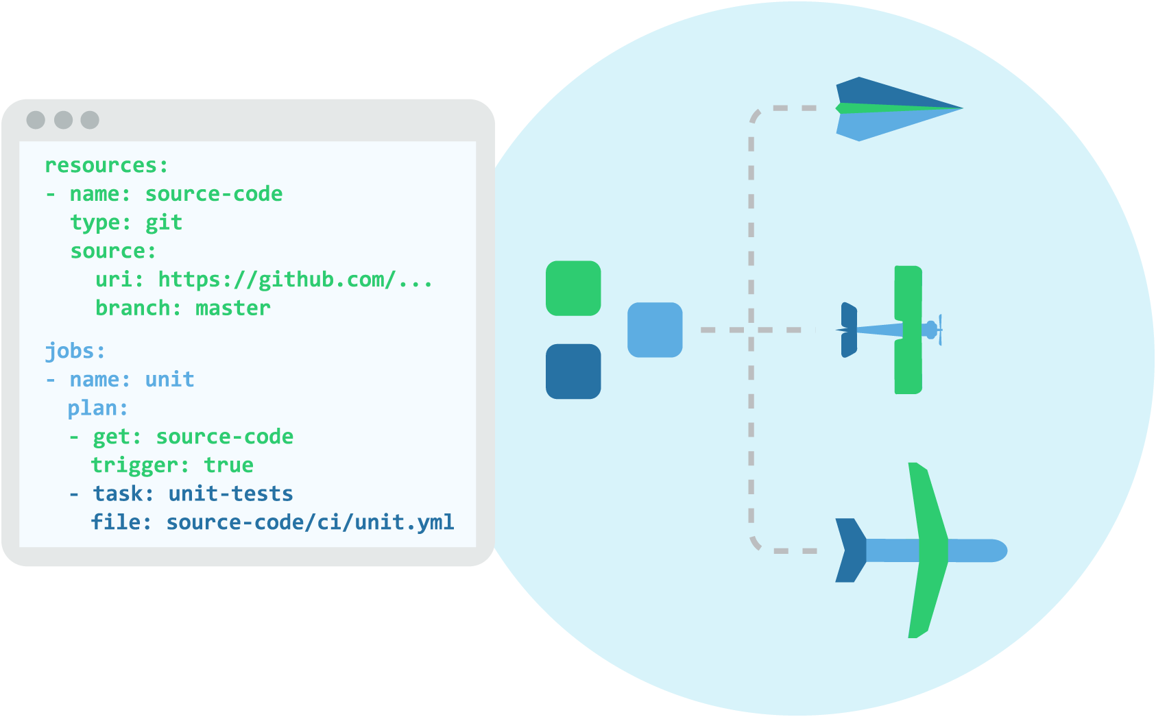
Simple and Scalable
Rather than a myriad of checkboxes, pipelines are defined as a single declarative config file, composing together just three core concepts.
As your project grows, your pipeline will grow with it, and remain understandable.

